Slide 1
Epigenetic differences between CD8 populations in T1D patients
5-23-2024 SI meeting
Ty Bottorff – Bioinformatics postdoc
Linsley lab
Notes:
P576-1 - ITN ATAC study - Better defining T_{ex} in teplizumab-treated subjects to inform combination treatments
Teplizumab: humanized anti-CD3 monoclonal Ab to delay onset of stage 3 T1D in people with stage 2 T1D. mechanism: weak agonist of TCR-CD3 to induce anergy/apoptosis of T cells (i.e. autoreactive Teffs I presume)
ATACseq relies on transposase that cuts and adds seq adaptors, prefers accessible chromatin

Slide 2
Outline
Motivation
Goal
QC
Preliminary results

Slide 3
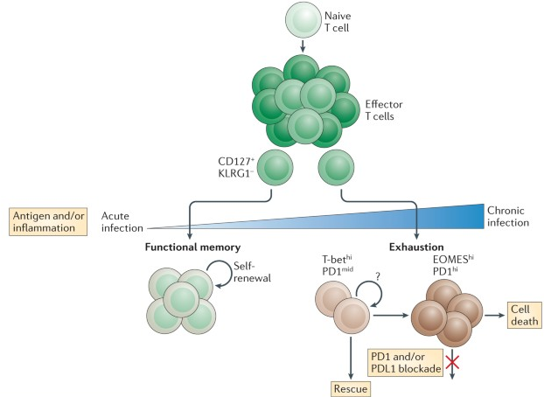
T cell exhaustion results from chronic antigen stimulation
Limited proliferation, effector function (cytokines)
IRs (TIGIT, PD1) and central TFs (EOMES, TOX) expressed
Inability to fully clear antigen
Wherry & Kurachi. Nat Reviews Immunol. 2015.
Notes:
Tex cells lack open chromatin sites in *Ifng* locus in Teff/TEM cells, Tex cells have open chromatin sites in *Pdcd1* locus (PD1), i.e. Teff down IR up it tracks
This green is non-exhausted CD127+
Autoimmunity still results likely because affinity between antigens and TCRs are low, so T cells don’t become overly exhausted (i.e. higher affinity TCR-neoantigens more strongly stimulate T cells and exhausts them)
With weakly stimulated but chronic antigens, T cells don’t exhaust (i.e. autoimmunity)
So in case of autoimmunity this is great, in case of cancer it associates with worse response
EOMES, TOX are exhaustion TFs
3 signal model for exhaustion: persistent antigen exposure, negative costimulatory signals, chronic inflammation
Evolutionary reason for Tex could be to minimize self-tissue damage with still controlling antigen somewhat
More and more exhaustion leads to terminal exhaustion & apoptosis

Slide 4
Levels of certain T_{ex} subpopulations can associate with autoimmunity intensity
Both PD1+ and CD57+ Tex subsets share phenotypic (hypoproliferation, IR expression) and epigenetic signatures of Tex, with CD57 Tex having more open chromatin in lytic and KIR regulatory genes (Witkop, Commun Biol in revision)
Higher levels of T_{ex} (TIGIT⁺ KLRG1⁺) CD8s associated with a) slower progression to T1D b) teplizumab response
Islet-reactive CD8s have more T_{eff} phenotype, less T_{ex} phenotype
Notes:
EOMES, TOX are exhaustion TFs
CD57⁺ (also high for NK associated genes), marker of cytotoxic function
PD1 is an IR/activation marker
TIGIT+KLRG1+ only partially exhausted, ie there are more exhaustion markers…
3 signal model for exhaustion: persistent antigen exposure, negative costimulatory signals, chronic inflammation
TEX are heterogeneous, with some TEX associating with better or worse outcome in cancer/chronic infection! So not always positive correlation b/w Tex and intensity of autoimmunity?
PD1 and CD57 Tex are both hypo-proliferative and express IR in T1DAL study (alefacept)

Slide 5
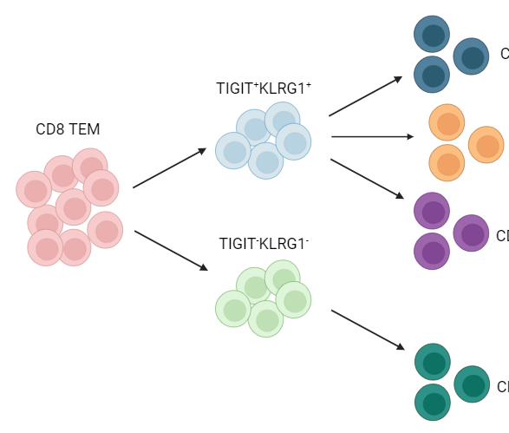
What naïve makrer used
Here?
TIGIT⁺
KLRG1⁺
CD57⁺
AbATE (teplizumab) subjects
CD8 not-naive
PD1⁺
What’s KLRG1??
Bulk
ATAC-seq
Sort
CD127⁺
8 responders, TIGIT⁺KLRG1⁺ high
8 non-responders, TIGIT⁺KLRG1⁺ low
CD127⁺
CyTOF
Ask peter about CyTOF data when sending slides
important intro plot: survival plots for CD127 worse outcome T1D, get intro slides from Peter's email
Notes:
CD127 = IL7R
Motivation for point 2:
PD-1+ associated with better outcome
CD127+ associated with worse outcome
Point #1: i.e. are some more Tex?
T1DAL: alefacept (LFA3-Ig fusion, binds CD2, disrupts CD58-mediated costimulation of T cells, selectively depletes memory/effector T cells)
CD2 costimulation can prevent exhaustion, alefacept (anti-CD2) can help treat T1D i.e. by allowing exhaustion presumably
Teplizumab: humanized anti-CD3 monoclonal Ab to delay onset of stage 3 T1D in people with stage 2 T1D. mechanism: weak agonist of TCR-CD3 to induce anergy/apoptosis of T cells (i.e. autoreactive Teffs I presume)
Epigenetic analysis of PD-1⁺ Tex subset may inform clinical trial design with PD-1 agonism
16 samples from anti-CD3 (AbATE) treated T1D, peak of response
Estimated cell yields (30K sorted cells for bulk ATAC)
Responder = <40% decline in C-peptide AUC in two years
Teplizumab: humanized anti-CD3 monoclonal Ab to delay onset of stage 3 T1D in people with stage 2 T1D. mechanism: weak agonist of TCR-CD3 to induce anergy/apoptosis of T cells (i.e. autoreactive Teffs I presume)
Also took cells for CyTOF (Tex markers and Teff, I’m not sure of results from this though…)
Blocking IL7R seems to protect against T1D, so CD127+ is associated with worse T1D prognosis

Slide 6
1. Are PD-1⁺ and CD57⁺ T_{ex} epigenetically exhausted here in teplizumab-treated subjects, as observed in TIDAL (alefacept)?
2. How do the subsets’ epigenetic profiles differ? What’s the lineage?
Make a small biorender to include here
As a model
for lineages?
Notes:
CD127 = IL7R
Motivation for point 2:
PD-1+ associated with better outcome
CD127+ associated with worse outcome
Point #1: i.e. are some more Tex?
T1DAL: alefacept (LFA3-Ig fusion, binds CD2, disrupts CD58-mediated costimulation of T cells, selectively depletes memory/effector T cells)
CD2 costimulation can prevent exhaustion, alefacept (anti-CD2) can help treat T1D i.e. by allowing exhaustion presumably
Teplizumab: humanized anti-CD3 monoclonal Ab to delay onset of stage 3 T1D in people with stage 2 T1D. mechanism: weak agonist of TCR-CD3 to induce anergy/apoptosis of T cells (i.e. autoreactive Teffs I presume)
Epigenetic analysis of PD-1⁺ Tex subset may inform clinical trial design with PD-1 agonism
16 samples from anti-CD3 (AbATE) treated T1D, peak of response
Estimated cell yields (30K sorted cells for bulk ATAC)
Responder = <40% decline in C-peptide AUC in two years
Teplizumab: humanized anti-CD3 monoclonal Ab to delay onset of stage 3 T1D in people with stage 2 T1D. mechanism: weak agonist of TCR-CD3 to induce anergy/apoptosis of T cells (i.e. autoreactive Teffs I presume)
Also took cells for CyTOF (Tex markers and Teff, I’m not sure of results from this though…)
Blocking IL7R seems to protect against T1D, so CD127+ is associated with worse T1D prognosis

Slide 7
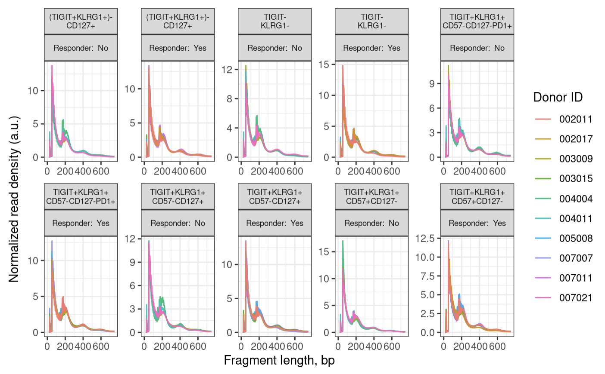
Fragment size distributions pass QC
Notes:
100 bp peak, 200, 400 bp oscillations
expect a peak around 100 bp (nuclesome free region) and then oscillations with maxima 200 bp mono-nucleosome, 400 bp di-nucleosome and so on
wiggles in the below plot are a biological feature and come from 10 bp per helical turn of the DNA
200 is like 2 100s together due to a nucleosome b/w preventing cut

Slide 8
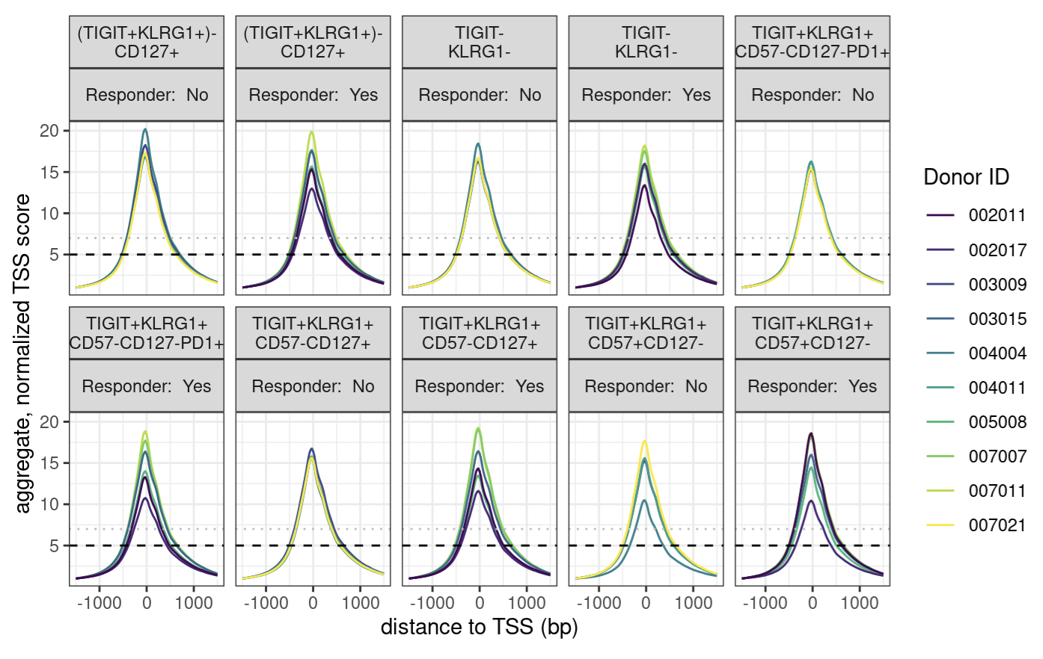
Enrichment over the TSS passes
Remake all QC plots with
Friendly labels
Like DP PD-1+
DN…
Notes:
enrichment over TSS, signal:noise
we are looking for > 7, while 5-7 is still acceptable

Slide 9
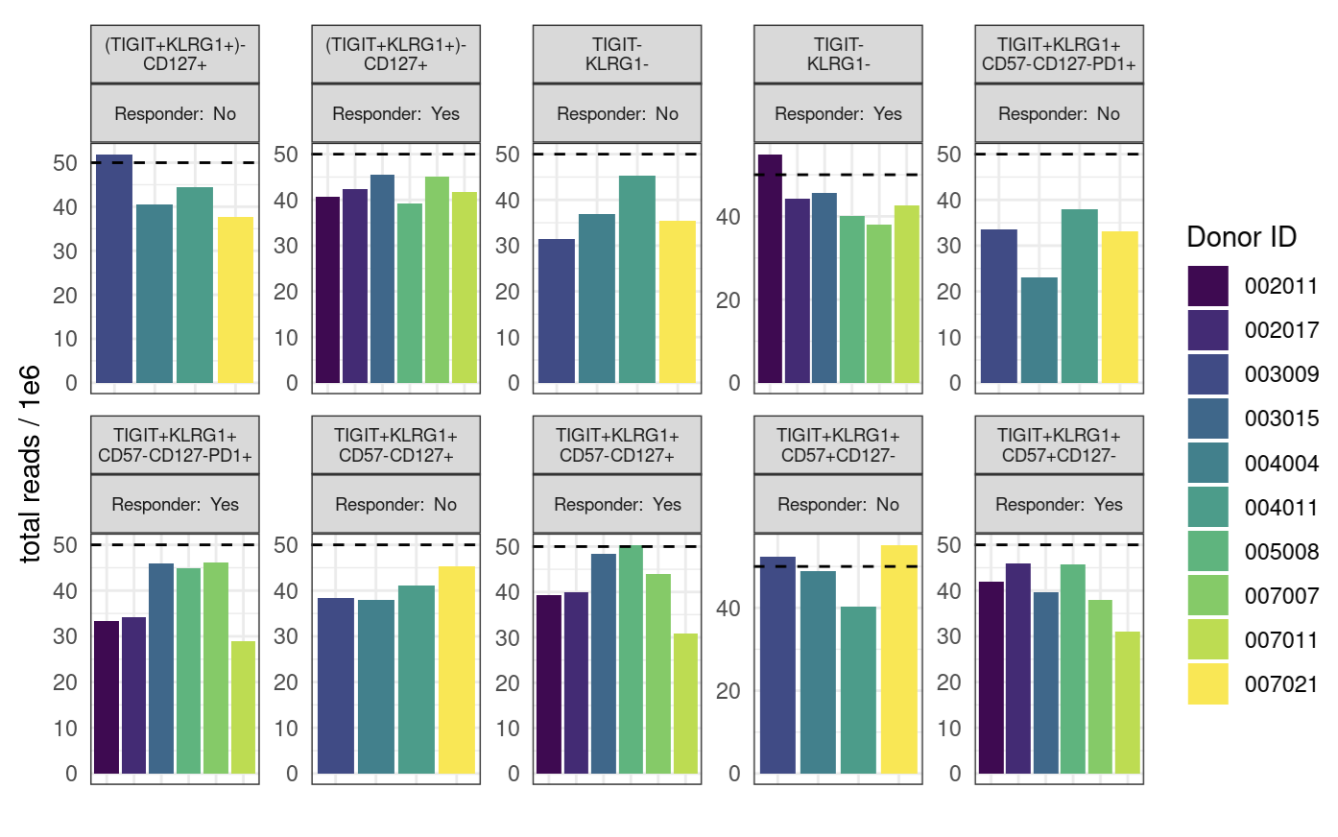
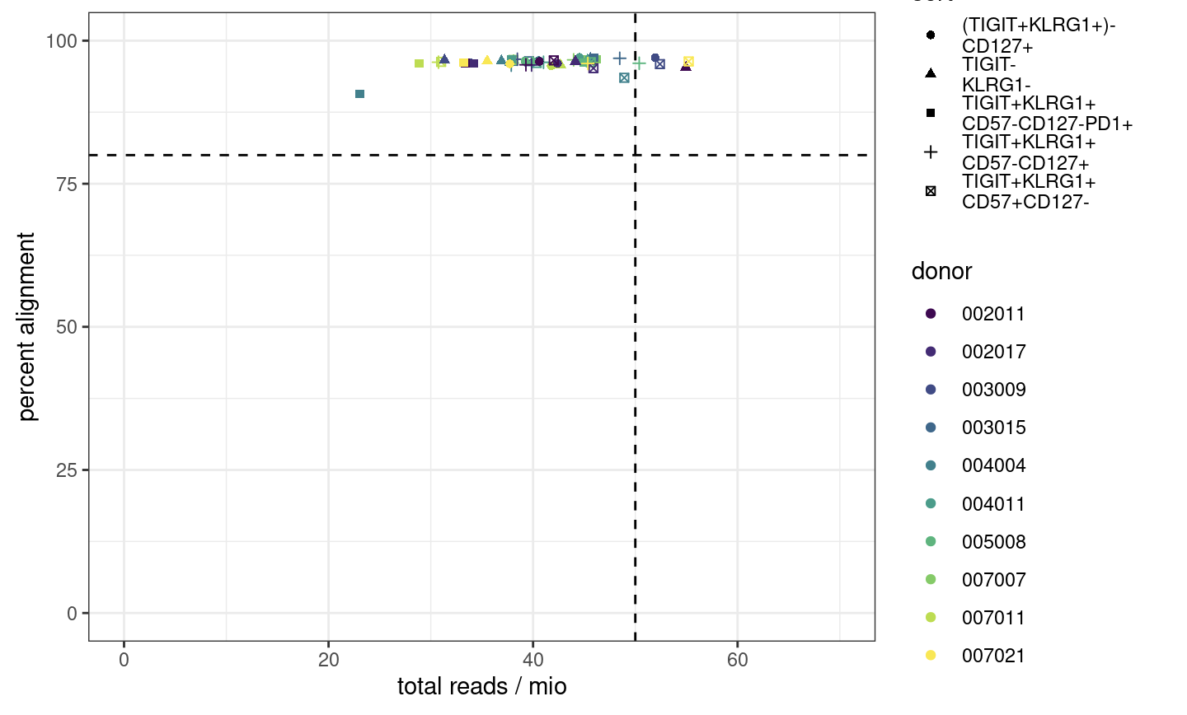
Read counts average BLANK, alignment passes
Notes:
ENCODE recommends 50 mio (aligned) reads for paired-end, 25 mio for single read
ENCODE: each replicate should have 25 million non-duplicate, non-mitochondrial aligned reads for single-end sequencing and 50 million for paired-ended sequencing (i.e. 25 million fragments, regardless of sequencing run type). The alignment rate, or percentage of mapped reads, should be greater than 95%, though values > 80% may be acceptable
want 10-50 mil reads depending on if TF analysis required (ENCODE suggestions)
we now want our samples to fall into the top right corner
consequences: may have reduced sensitivity (for low abundance/rare stuff), increased noise, decreased reproducibility across replicates (i.e. within sort+responder groups)
P452 may have had more reads/library because less libraries for the flowcell… Vivian expected P576-1 reads average around 50M but they were on average lower…

Slide 10
Obtaining peaks across samples
QC summary: all libraries pass
Merge alignment .bam files (pile up reads) by study group (cell sort + responder status)
Call peaks on merged alignment files
Merge peaks to obtain “consensus peaks” (candidate genomic regions for biological relevancy across samples)
Analogous to pseudobulking I think? Mostly 1-3
Notes:
Consensus = relevant across samples vs. just in 1/few samples
Consensus peaks = candidate regions (binned genome), we need them because we need to be looking at peaks that are relevant across samples vs. peaks just in 1/few samples?
*2-4 are an alternative to default of obtaining consensus peaks by fixed list of 400 bp wide peaks overlapping between > 2 samples (washes out signal)
This approach deals with different peak widths across samples better, obtaining more representative peaks, should be more sensitive
Is this kind of like pseudobulking?

Slide 11
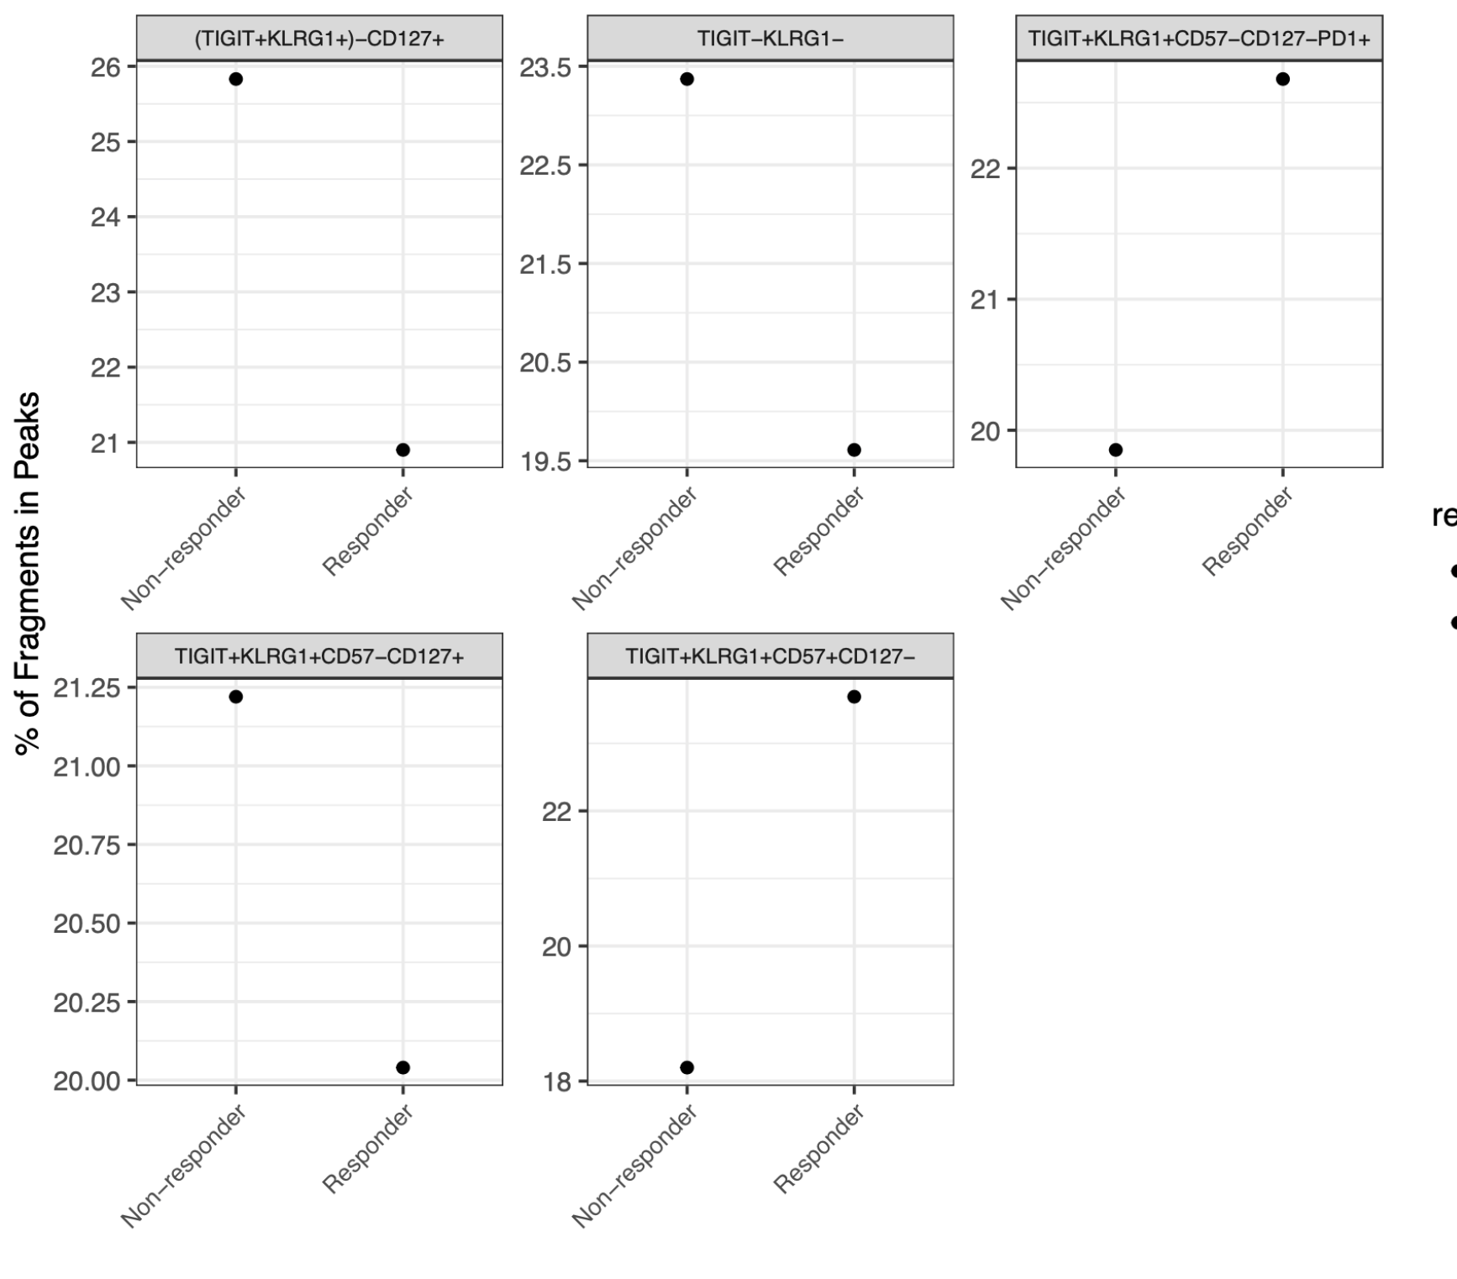
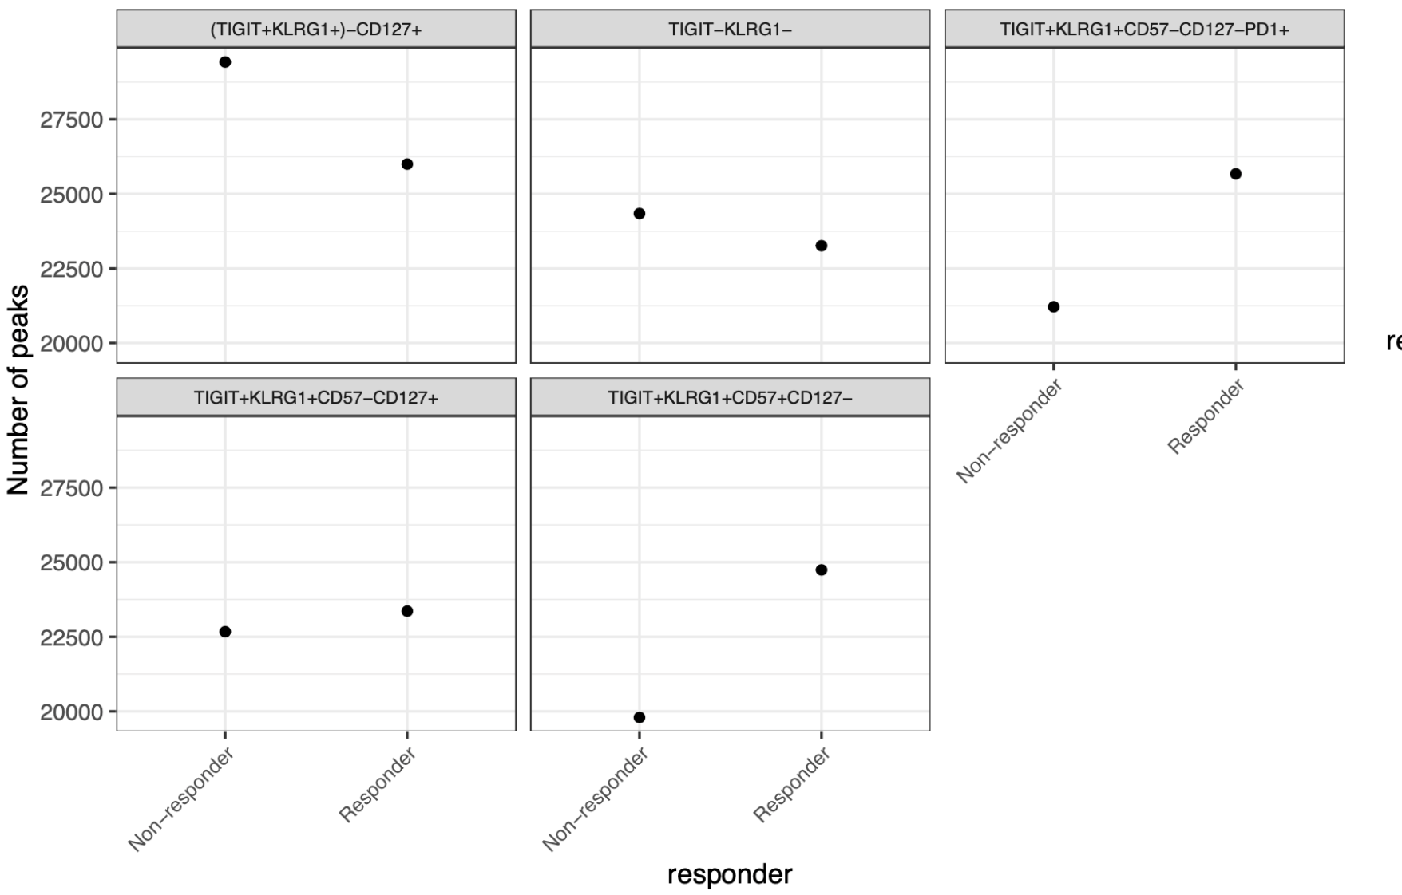
As expected, FRiPs are higher after merging alignment and peak files; peak counts are still lower than expected (still similar to P452)
Notes:
Merging:
Old Erin way: make the consensus peak set using peaks identified in at least two samples
New Stephan way: merged peaks from peaks called on merged alignment files by study group?

Slide 12
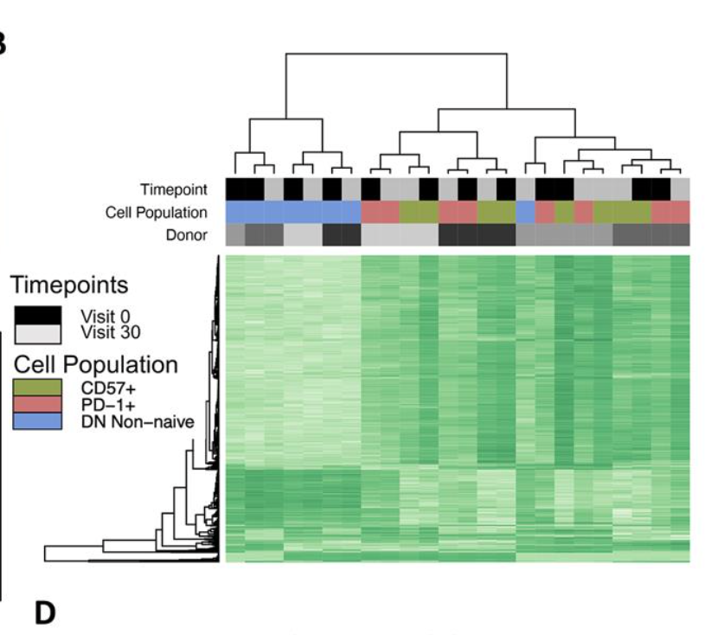
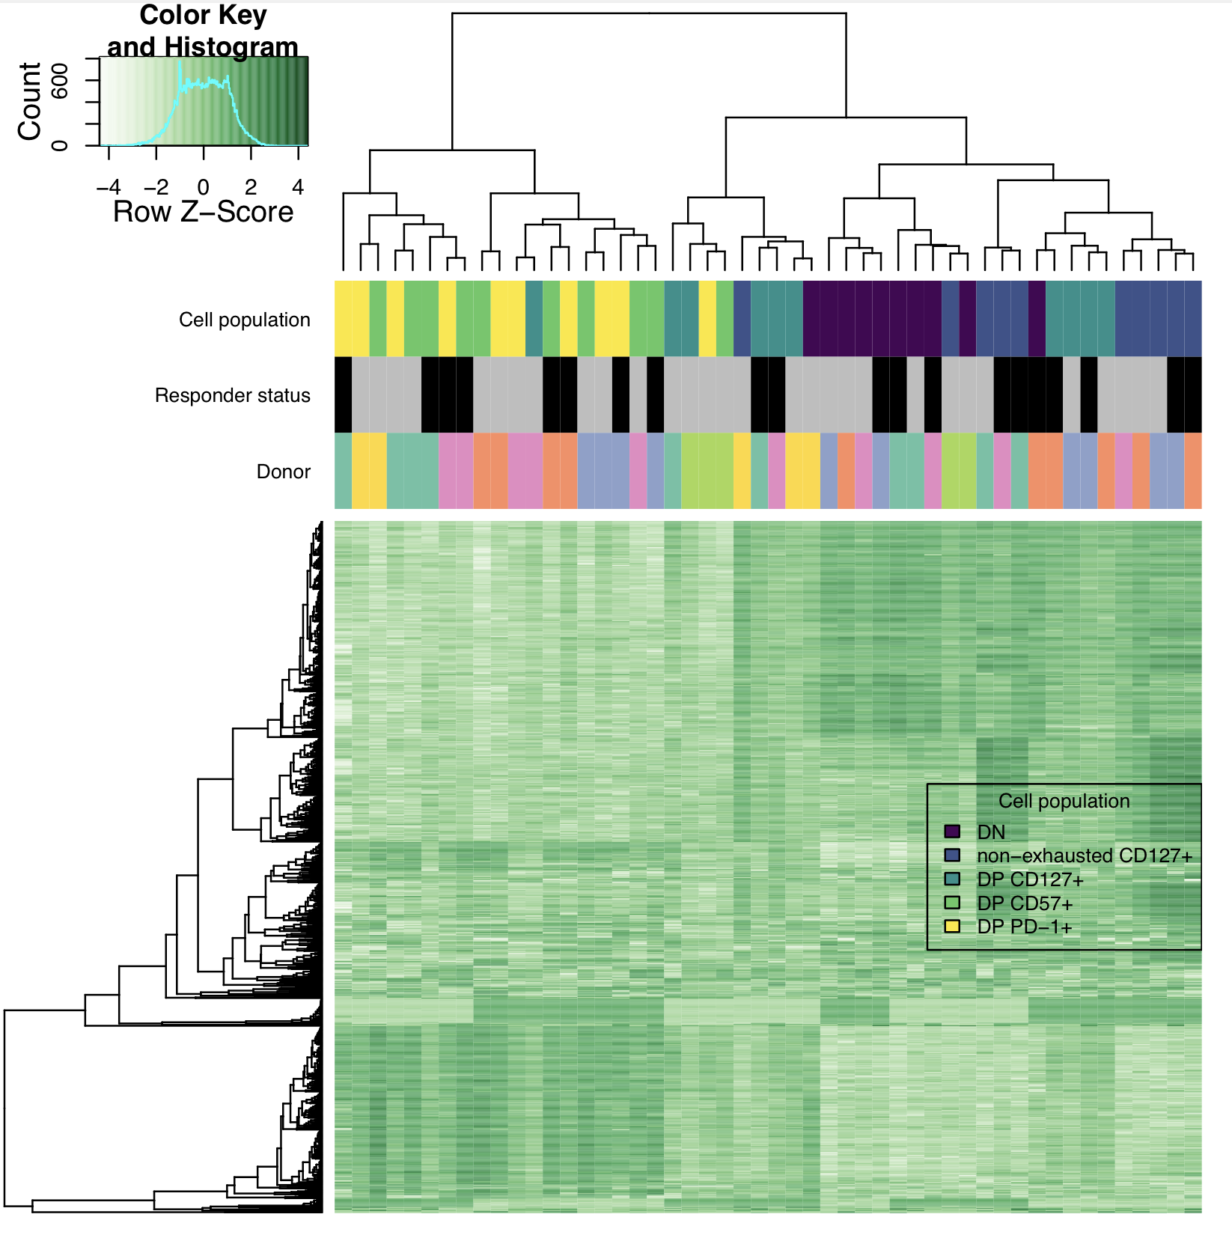
DP CD57⁺ and DP PD-1⁺ cluster together, away from DN in both projects, DP CD127⁺ seems to cluster separately (as do DN/non-exhausted CD127⁺) in P576
SI: should show SOME of Erin's figs to show that my analysis is consistent...
P576
P452 (Erin’s)

Slide 13
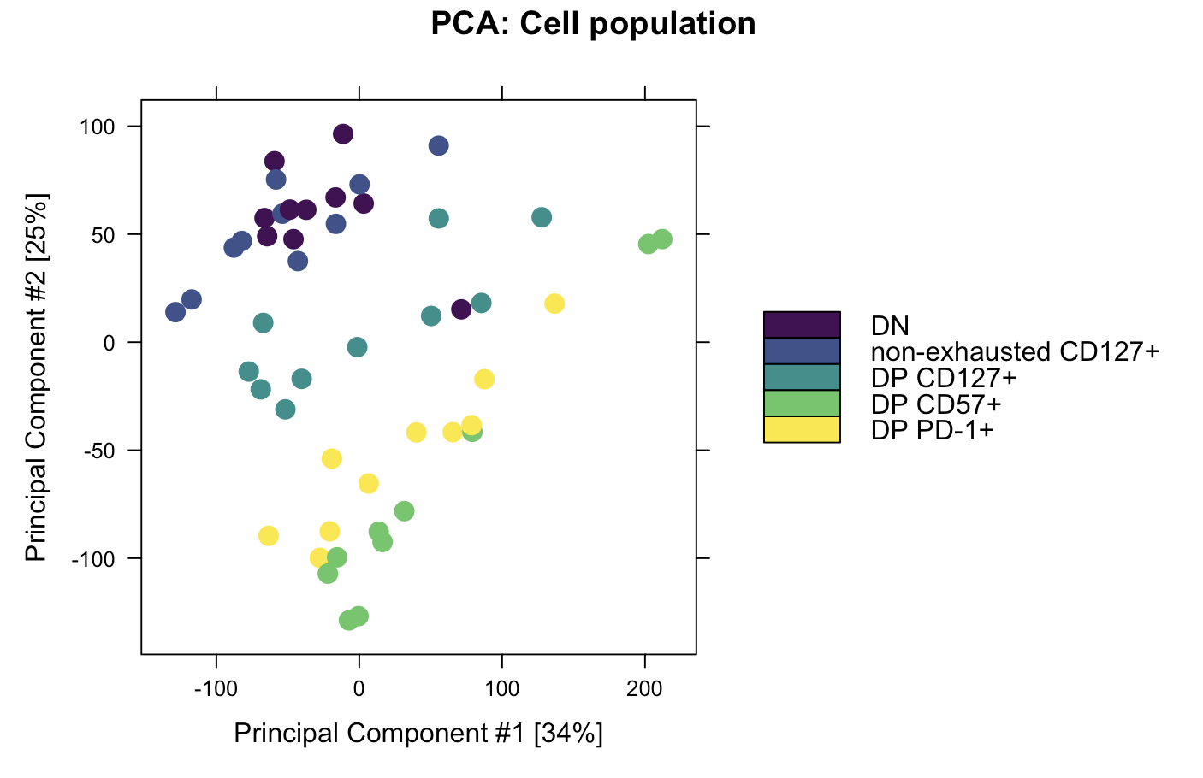
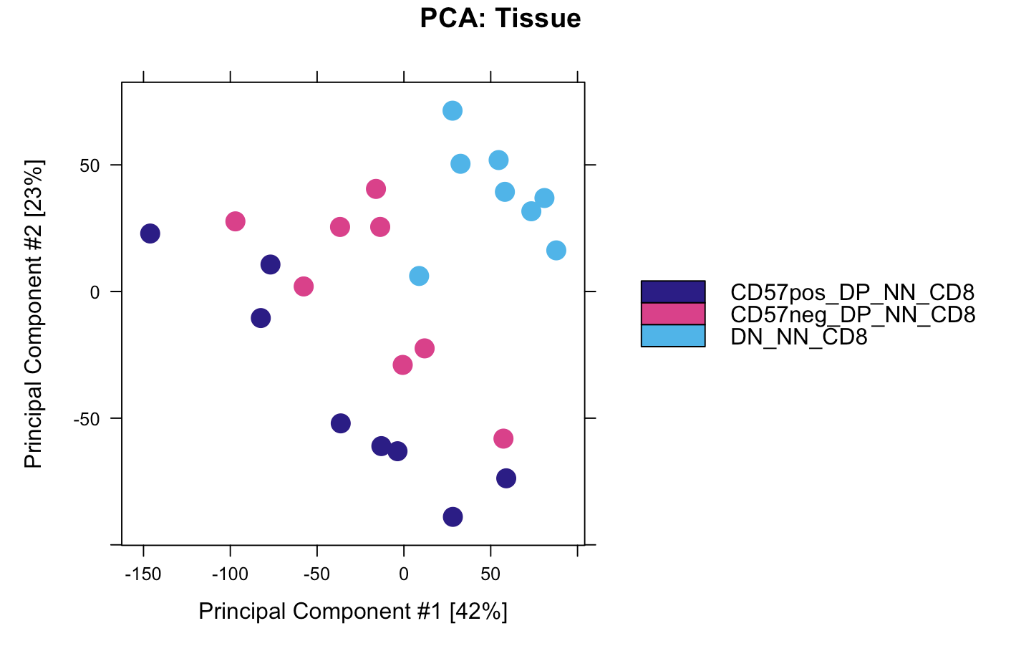
DP CD57⁺ and DP PD-1⁺ cluster together, away from DN in both projects, DP CD127⁺ seems to cluster separately (as do DN/non-exhausted CD127⁺) in P576
add PCA/heatmap or whatever as evidence for R/NR not mattering here... ie no differences b/w them. this is a conclusion!
P576
P452 (Erin’s)
Notes:
Rows in heatmap are peaks?

Slide 14
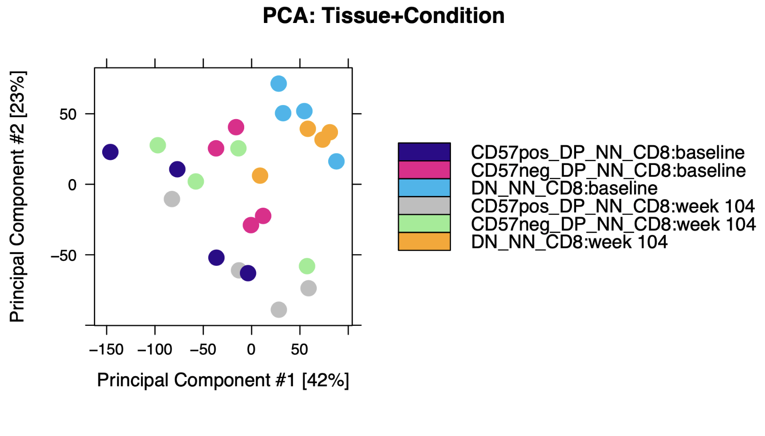
Donor to donor variability
P452
Exhaustion: CD244, SLAMF6, TBX21, PDCD1, HAVCR2, KLRG1, TOX, TCF1, PD1, CTLA4, LAG3, TIM3, TIGIT, KIR3DL2, KIR2DL3, NKG2A
Cytotoxicity: GZMA, GZMB, GZMH, GZMM, GZMK, PRF1, NCR1, KLRF1, NKG7

Slide 15
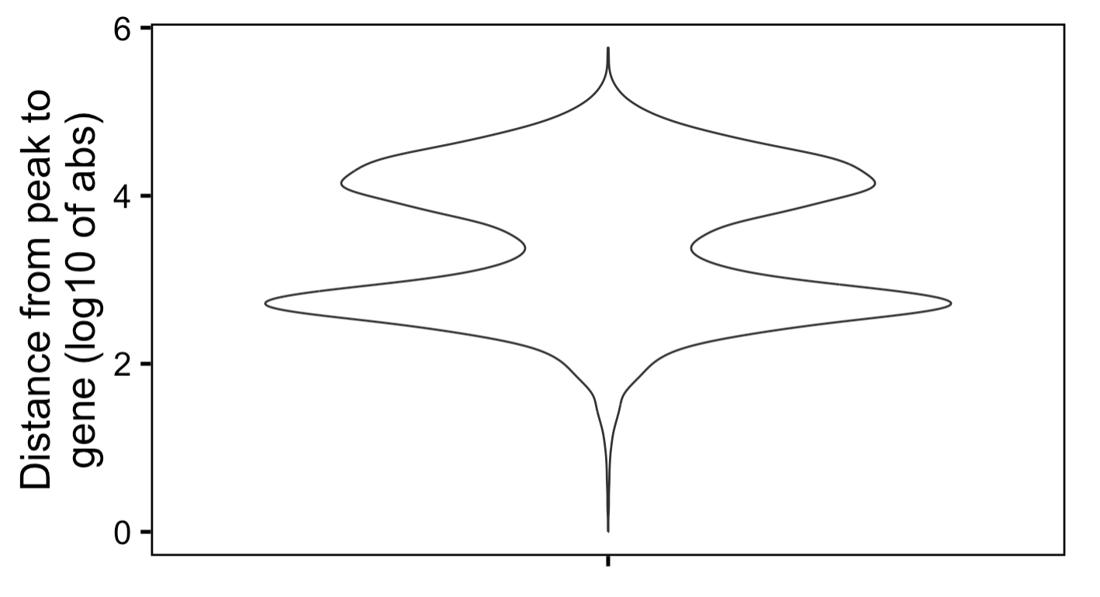
Most peaks far away from genes (> 5 kb)

Slide 16
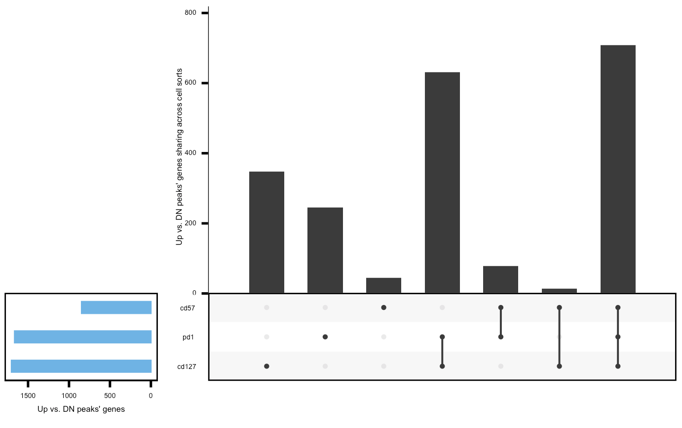
Sharing of peaks’ closest genes/promoters doesn’t follow expectation of DP CD127⁺ being a distinct lineage with more sharing between DP PD-1⁺ and DP CD57⁺
THIS IS BETTER SLIDE THAN NORMALIZED SET SIZE
BUT SHOULD REALLY get
2nd bar next to these bars that’s like
Expected yval based on set sizes and # of distinct genes
May be hard to add to plot, but can reference val
To say like (guessing) pd1-cd57 more than expected
As well as pd1-cd127 IF pd1 intermediate
Less cd57-cd127 than expected
Can also do expected yval for all 3 to say like
All 3 are more similar than expected by chance
ALSO!! Can do stats on these expected vs. observed vals
Is this chi squared?
peak sharing upset: put pd1 in middle row to help sell point that its intermediate, consider just going back to Venn as well...
filtered for differentially accessible peaks with highest abs(FC) per gene (or promoter, similar results if using median)
then filtered for FC > 0 vs. DN
similar results if filtering for peaks < 5 kb from genes
Notes:
Looks similar for promoters
KIRs aren’t present in the unique to DP CD57⁺ fraction (not surprising, they don’t show up vs. DN, only vs. DP PD-1⁺)

Slide 17
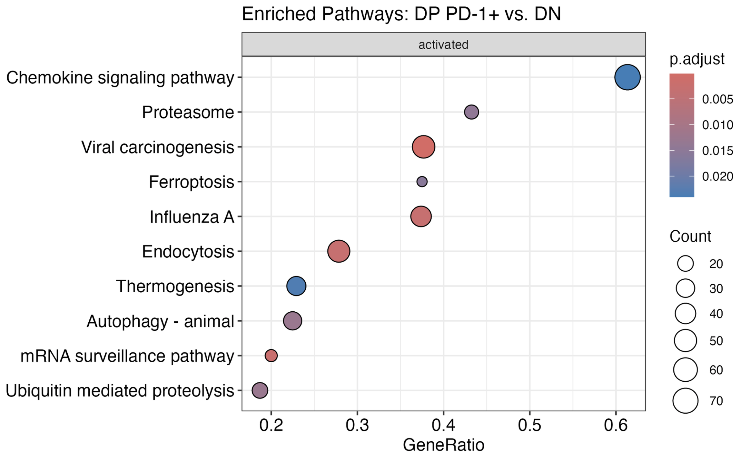
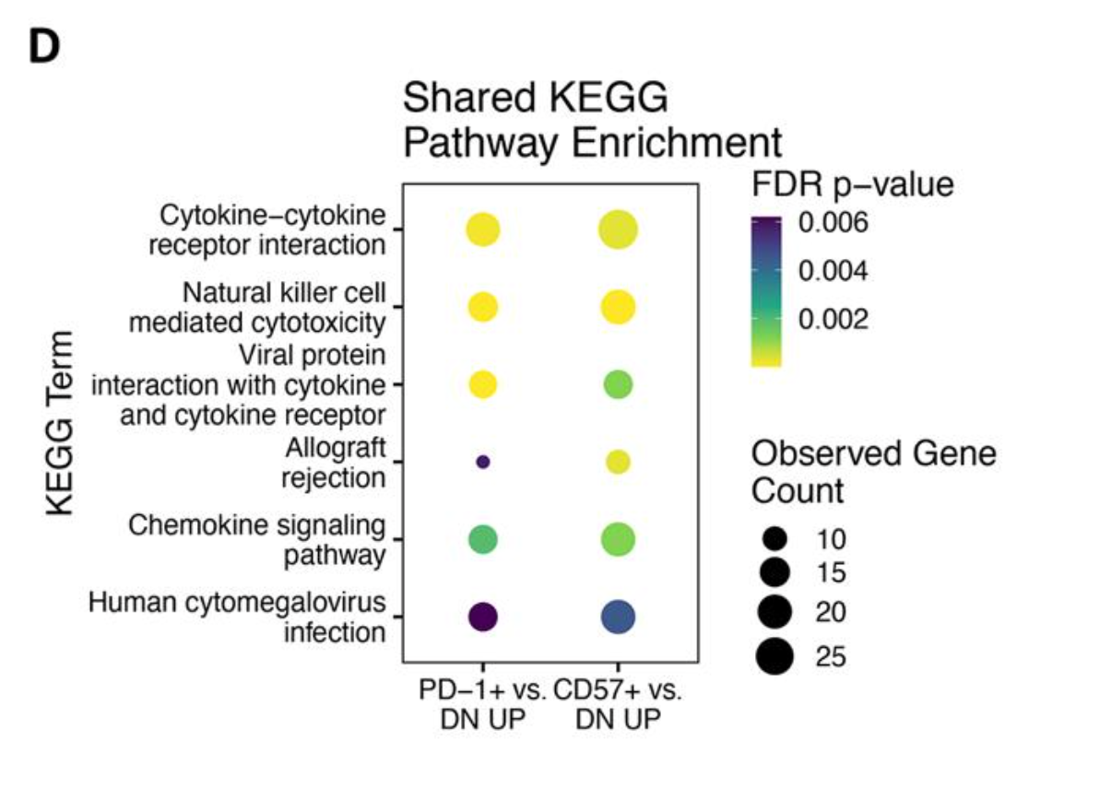
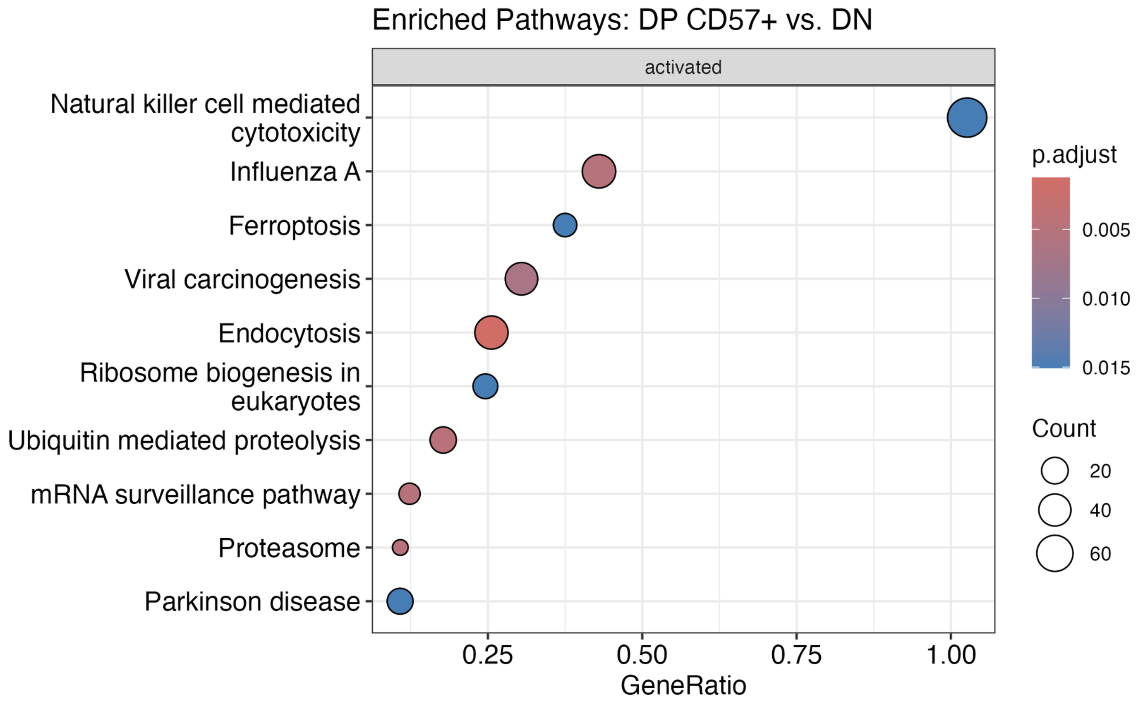
KEGG analysis not very similar between projects (methodology?)
!
!
!
!
P576
P452 (Erin’s)

Slide 18
PPIs for all contrasts, ideally remake in igraph? VPs too… Mean coverage plots…
PPI: PD-1 up vs. CD57 vs. Erin actually yes do see IL7R and CD80 in both so not completely different
make sure all plot colors are shared (looking at heatmap R/NR color not shown)
Include legible text labels for VPs for top/interesting hits
Yes show Homer results at SI, interested in DP vs. DP differences and the fact that it's not SUPER consistent with Erin's doesnt mean I shouldn't show...
How does patient variability fit into mean coverage plots and Homer results? would be nice to show somehow... like how many Tcf7 motifs in peaks in each patient?
PLOTS SHOULD BE SQUARE UNLESS PURPOSEFULLY NOT, like VPs (also make sure text legible!!)

Slide 19
Conclusions
add PCA/heatmap or whatever as evidence for R/NR not mattering here... ie no differences b/w them. this is a conclusion!

Slide 20
Next steps

Slide 21

Acknowledgements
Peter Linsley
Bioinformatics group
Alex Hu
Erin Witkop
Matt Dufort
Matt Lawrence
Hannah DeBerg
Thomas Edwards
Tomasz Janczyk

Slide 22
Extra slides

Slide 23
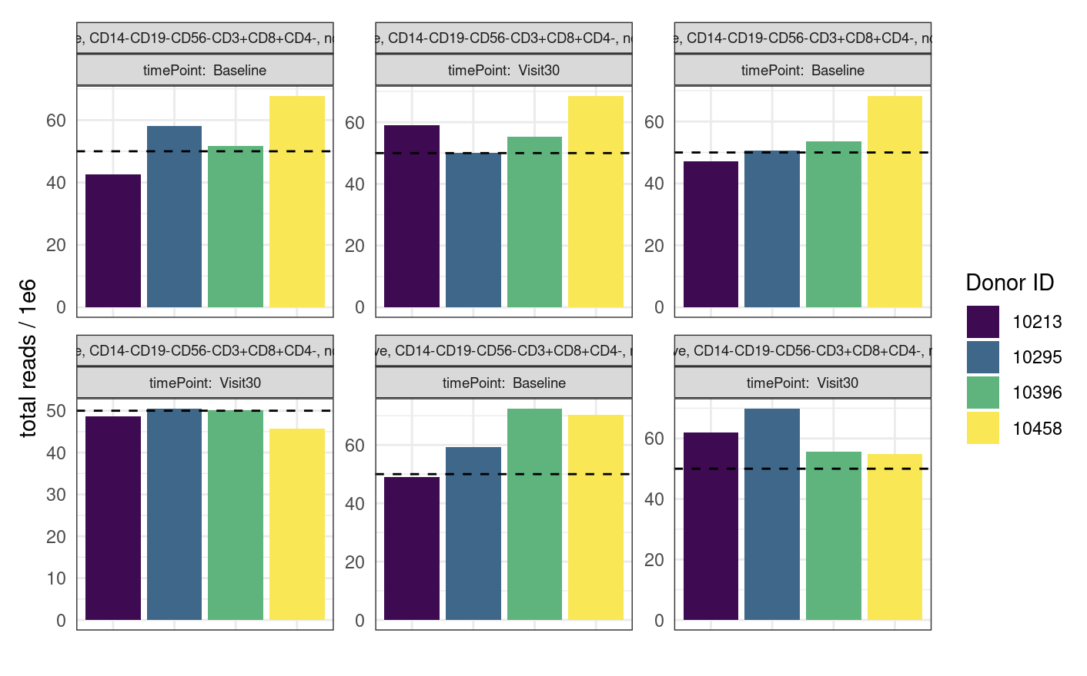
P452 QC comparable to that of P576-1 but does have more reads

Slide 24
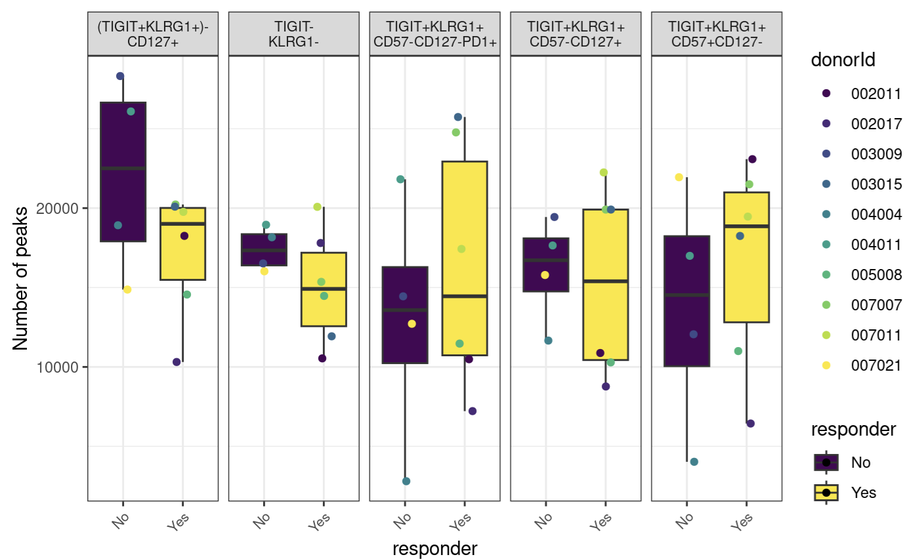
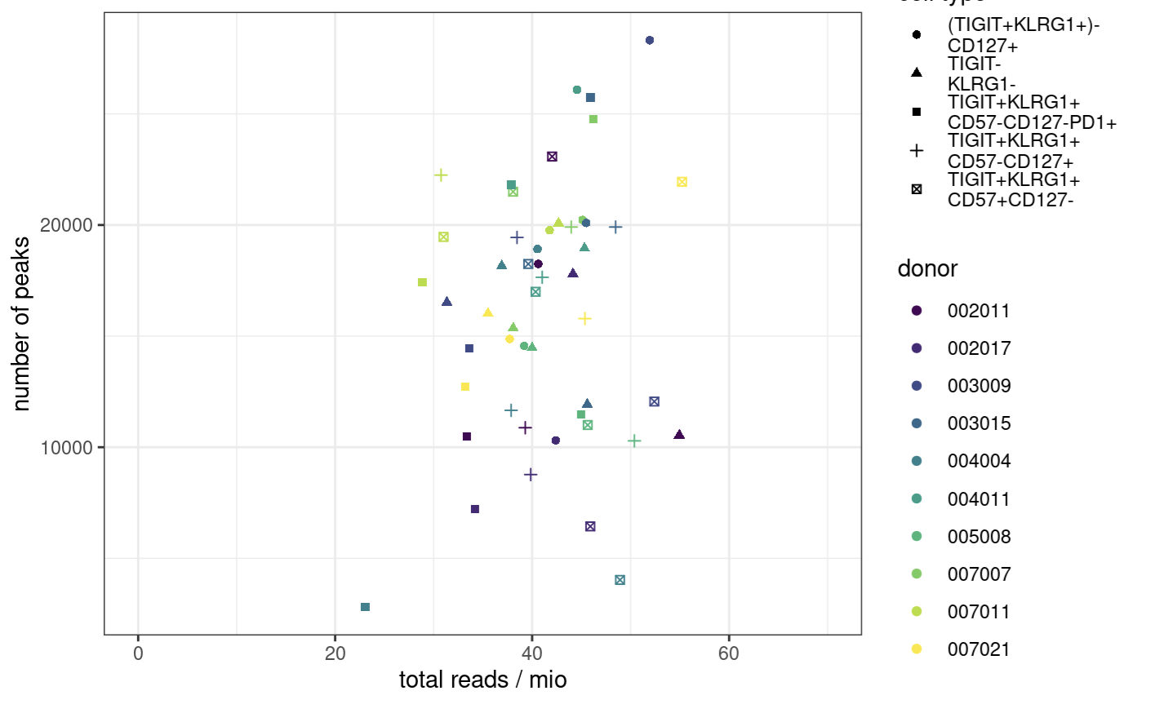
Peak counts
Notes:
ENCODE:The number of peaks within a replicated peak file should be >150,000, though values >100,000 may be acceptable.
ENCODE recommends > 150,000 peaks, although > 100,000 is still acceptable

Slide 25
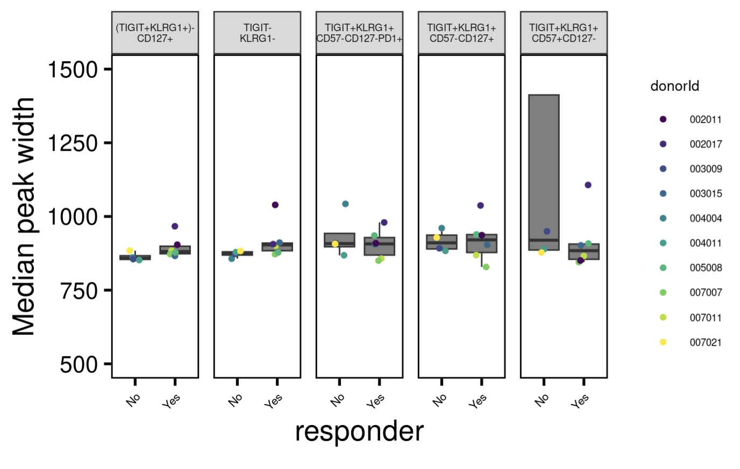
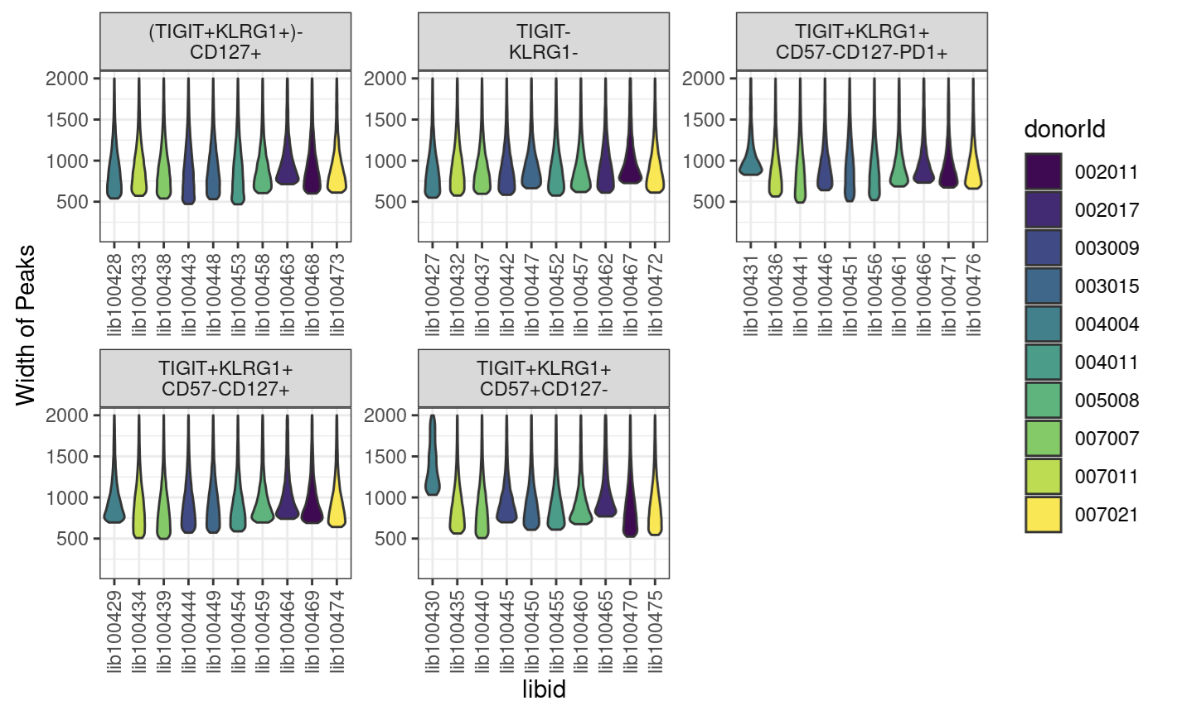
Peak widths
Notes:
want ~400-1000 bp peak widths as medians
libid100430 is wide peak one

Slide 26
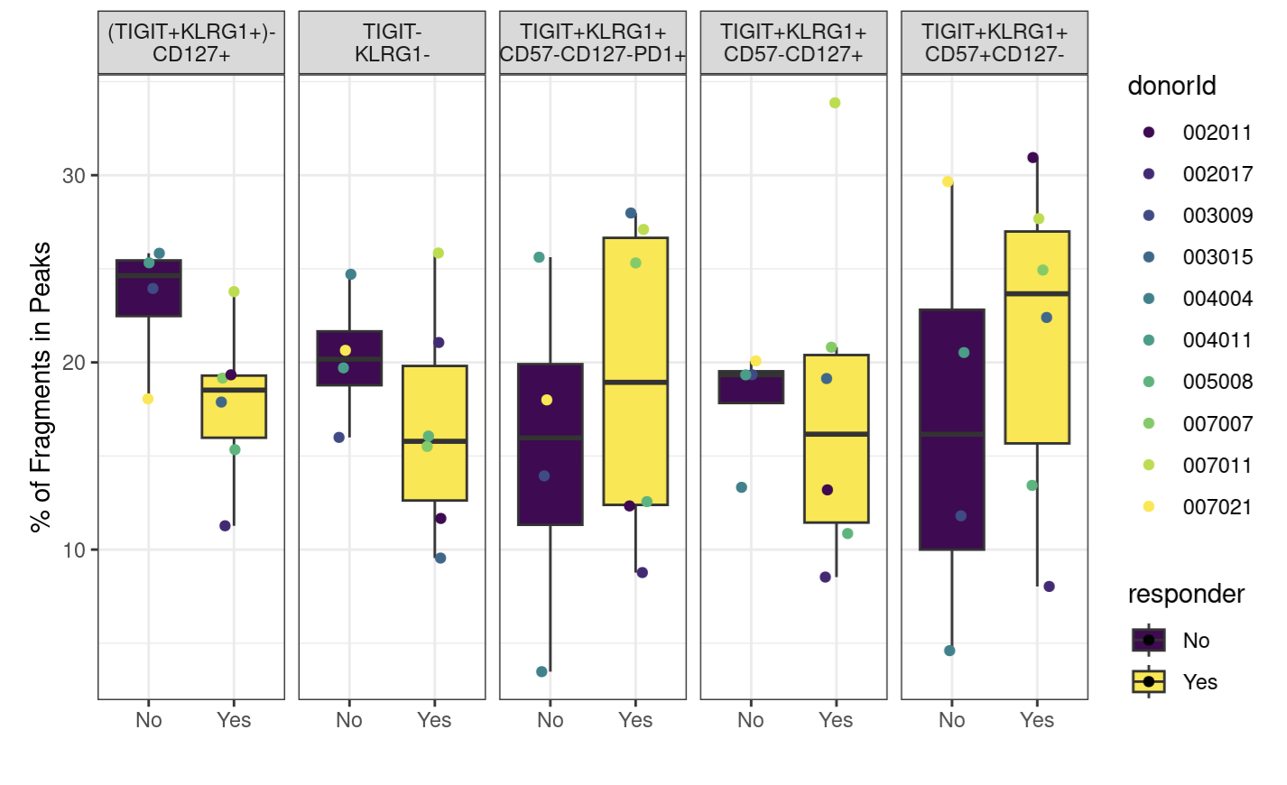
Fraction of reads in peaks
Notes:
ENCODE: The fraction of reads in called peak regions (FRiP score) should be > 0.3, though values greater than 0.2 are acceptable. TSS enrichment remains in place as a key signal to noise measure
FRiP is calculated by going through the bam files and counting the reads that fall within a called peak

Slide 27
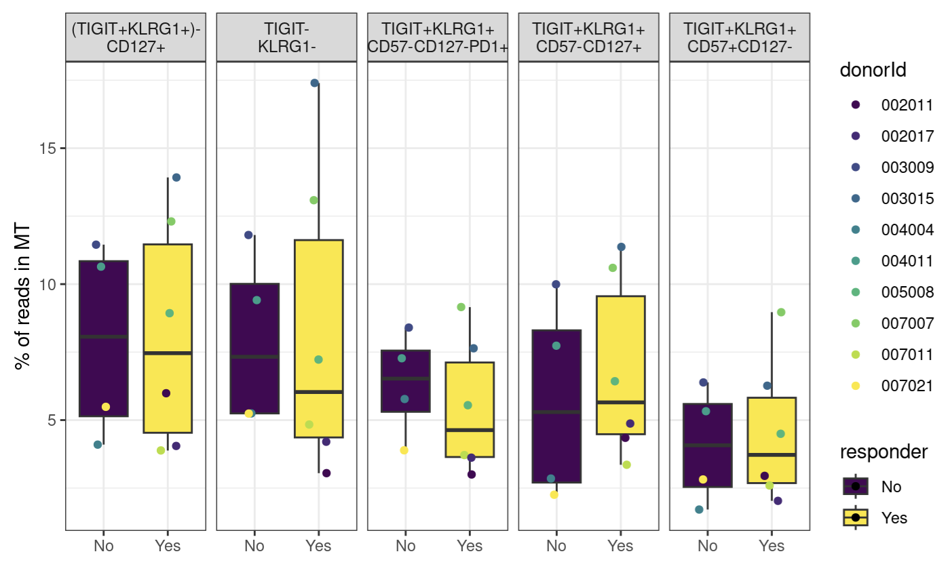
MT %s

